Slide 1
Flight Price Prediction
John Tojo
Data Science Intern

Slide 2
Overview
Introduction
Problem Statement
Exploratory Data Analysis (EDA)
Observations from graphs
Data cleaning
Model Selection
Conclusion
Future Work

Slide 3
Introduction
Flight price prediction is a crucial task for both airlines and consumers
The airline industry is highly competitive, with airlines constantly adjusting prices
There are various techniques and models used for predicting flight prices
Understanding how flight prices are predicted can help make informed decisions when booking a flight

Slide 4
Problem Statement
The problem of flight price prediction is a complex one, as the prices of flights are affected by various factors such as time of purchase and route distance. Airlines often adjust prices based on these factors in order to maximize revenue and fill seats on flights. For example, prices may be lower for early bookings, and higher for last-minute bookings or flights that are filling up quickly. Additionally, prices may vary depending on the route, with longer or more popular routes typically having higher prices.
The goal of this project is to develop a model that can accurately predict flight prices by analyzing historical data and other relevant factors. This project aims to:
Collect and clean a dataset of flight fare data and other relevant features such as time of purchase route distance, and airline carrier
Analyze the data to identify trends and patterns in flight prices
Implement and evaluate different machine learning models to predict flight prices
Optimize the model by fine-tuning hyperparameters and feature selection

Slide 5
Data Scrapping
The data used in this project was scraped from the travel website MakeMyTrip.com. The data was collected for flights between 8th to 11th day of the month
The scraped data contains the following columns:
'Airline': The airline company operating the flight.
'Travel_date': The date of the flight.
'From': The departure city or airport of the flight.
'To': The arrival city or airport of the flight.
'Departure_time': The departure time of the flight.
'Arrival_time': The arrival time of the flight.
'Duration_minutes': The duration of the flight in minutes.
'Stops': The number of stops on the flight.
'Price': The price of the flight.

Slide 6
The 'Airline' column provides information about the airline company that is operating the flight. This information can be used to analyze the prices of different airlines and how they vary.
The 'Travel_date' column provides information about the date of the flight, which can be used to analyze how prices vary over time.
The 'From' and 'To' columns provide information about the departure and arrival cities or airports of the flight. This information can be used to analyze how prices vary depending on the route.
The 'Departure_time', 'Arrival_time' and 'Duration_minutes' columns provide information about the departure and arrival times of the flight, and the duration of the flight. This information can be used to analyze how prices vary depending on the time of day or the duration of the flight.
The 'Stops' column provides information about the number of stops on the flight. This information can be used to analyze how prices vary depending on the number of stops.
The 'Price' column is the target variable, which provides information about the price of the flight. This information is used to train and evaluate the model.

Slide 7
Exploratory Data Analysis (EDA)
used df.info() to check for information about the data, such as the data types and number of non-null values for each column.
converted the travel_date column to a datetime data type and extracted the day of the month, adding a new column called day and dropping the original travel_date column.
checked for and removed any duplicate records in the dataset, in this case 6 records were duplicate.
checked for unique data present in each columns
checked for null values and found 4, but since it existed on the same row so dropped it.
created new columns Arrival_time_hour and Arrival_time_min from the Arrival_time column, and dropped the original Arrival_time column. Similarly, did the same with the Departure_time column as well.

Slide 8
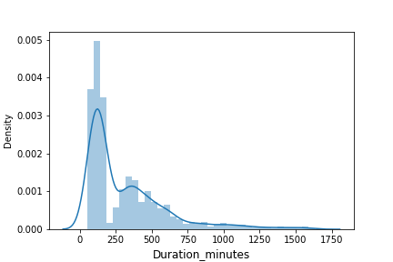
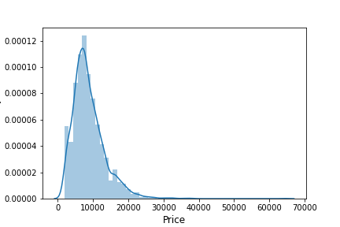
Univariate Analysis numerical continuous
The mean duration of the flights is around 313.8 minutes, with a standard deviation of 282.88 minutes
The minimum duration of the flight is 55 minutes and the maximum duration of the flight is 1635 minutes
The mean price of the flights is around 8825.76, with a standard deviation of 4651.56
The minimum price of the flight is 1899 and the maximum price of the flight is 64163
The duration of flight and prices of flight have wide range of variation
presence of outliers

Slide 9
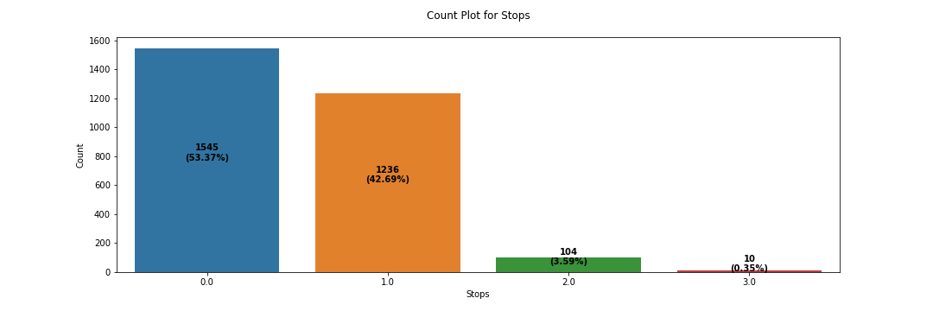
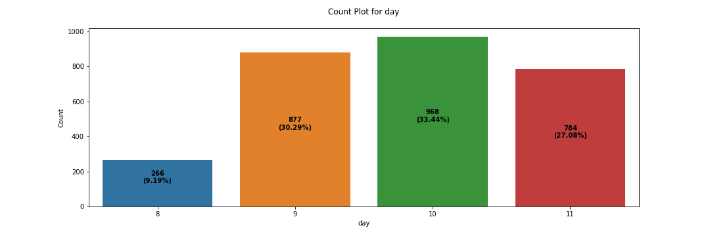
Univariate Analysis numerical discrete
The mean number of stops for flights is around 0.509154, with a standard deviation of 0.585327.
The minimum number of stops for a flight is 0 and the maximum number of stops for a flight is 3.
most of the flights are non stop followed by 1 stop
The mean day of flight is around 9.784111, with a standard deviation of 0.946033.
The minimum day of flight is 8 and the maximum day of flight is 11.
most of the data is accumulated on day 10 followed by day 9

Slide 10
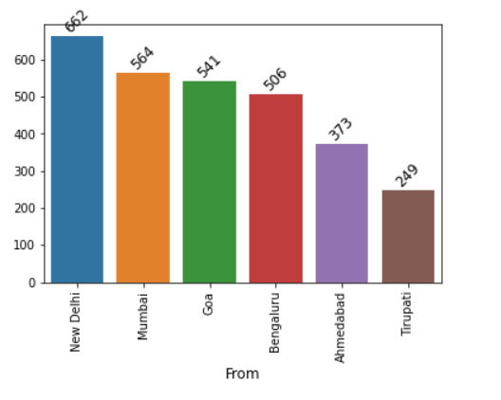
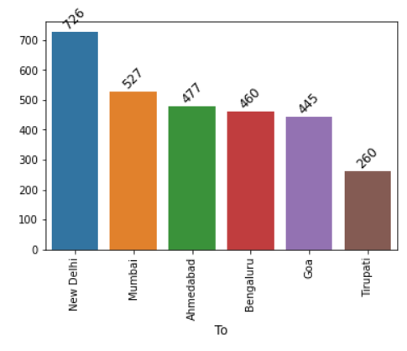
Univariate Analysis categorical data
based on To and From inference
New Delhi is a popular destination: The fact that most people are traveling to New Delhi suggests that it is a popular destination among travelers.
Tirupati is not as popular a destination: The fact that least people want to travel to Tirupati indicates that it is not as popular a destination as New Delhi.
New Delhi is a common starting point: The fact that most people are traveling from New Delhi suggests that it is a common starting point for many travelers.
Tirupati may be a less-populated area: The fact that least people are traveling from Tirupati suggests that it may be a less-populated area compared to New Delhi.
New Delhi may be a more accessible location: The fact that most people are traveling from and to New Delhi suggests that it may be more easily accessible to people.

Slide 11
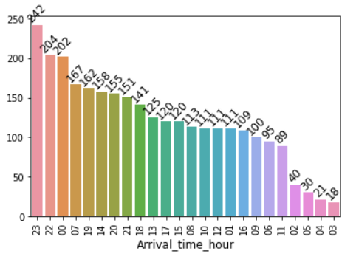
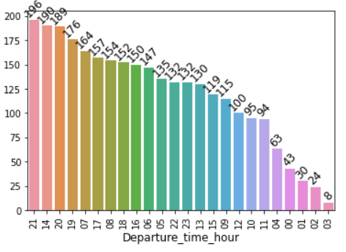
Univariate Analysis categorical data
based on arrival and departure times
There are more flights scheduled to arrive at 23 hr than at 03 hr.
There may be a higher demand for flights at 23 hr than at 03 hr.
The airport may have more capacity to handle flights at 23 hr than at 03 hr.
There could be operational reasons such as less congestion or traffic at 23 hr than at 03 hr, so flights are scheduled to arrive at that time.
there is higher arrival of flight at 21 hr than at 03 hr
it can be seen that most of the flights depart and arrive at the latter half of the day
The company has chosen that time as it may be cheaper to operate during those hours.

Slide 12
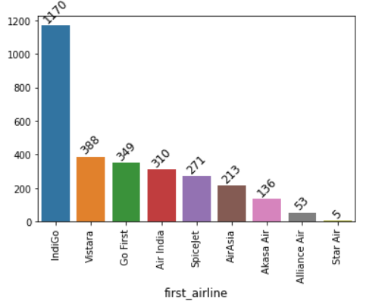
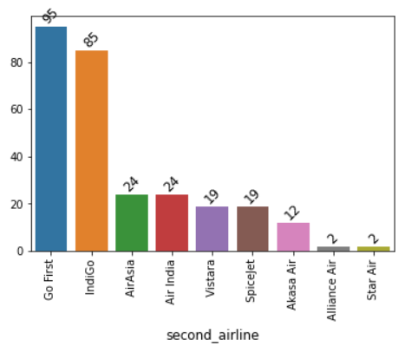
Univariate Analysis categorical data
based on first_airline and second_airline(connection airline if there are stops)
Indigo has a better reputation and customer satisfaction than StarAir.
People may find Indigo flights more affordable or convenient than StarAir flights.
Gofirst may have a better reputation or provide better service than Star Air for connecting flights.
People may find Gofirst flights more affordable or convenient than StarAir flights for connecting flights.

Slide 13
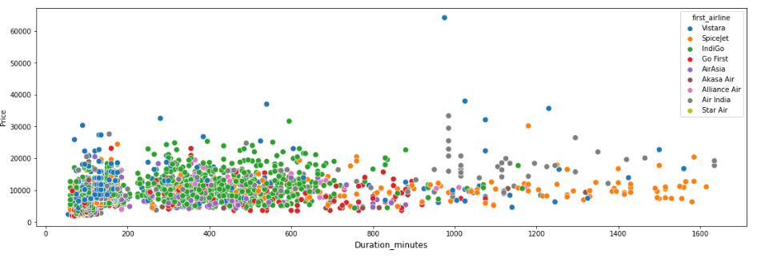
Bivariate Analysis
Vistara is faster but more expensive than other airlines.
Indigo offers more options for non-stop and connecting flights, and its connecting flights are comparatively cheaper.
Air India flights are more expensive and take longer to reach the destination.
Spice Jet has longer duration flights indicating multiple stops and is cheaper than the other airlines.
Indigo may have a larger market share for domestic flights than other airlines.
Vistara may be considered as a higher quality airline than the other options.
Air India may be preferred for international flights rather than domestic flights.
Spice jet may be used for low-budget or travel for time constraints, but it will take longer time to reach the destination.

Slide 14
Bivariate Analysis
Goa to Ahmedabad on Vistara with 1 stop, the median price is quite different depending on the day of the week. It's lowest on day 10 at 6101 and it's highest on day 8 at 32110. Similarly, for flights from Ahmedabad to Goa on Vistara with 1 stop, the median price is lowest on day 10 at 5214 and highest on day 8 at 8280.5.
For flights between Goa and Tirupati on SpiceJet with 1 stop, the prices tend to be more expensive on days 8, 9, and 11. Additionally, it also appears that the prices for flights between Goa and Tirupati tend to be more expensive than flights between other destinations.
For flights between Tirupati and Bengaluru on Star Air with 1 stop, the prices are consistent with Q1, Q3 and median fare being 7612 on day 9, and 7969 on day 11. This implies that the fare prices do not vary much. Similarly, for the route Bengaluru to Tirupati, the prices are consistent with Q1, Q3 and median fare being 13822 on day 9, and 6612 on day 11.
For flights between Goa to Ahmedabad on Vistara with 2 stops, the highest ticket price is observed on day 8 with 64163.0. Similarly, the highest median prices are observed on day 9 for Ahmedabad to Tirupati on Vistara with 2 stops, on day 8 for Tirupati to Mumbai on SpiceJet with 2 stops, on day 11 for Tirupati to Ahmedabad on IndiGo with 2 stops, on day 9 for Mumbai to Tirupati on IndiGo with 2 stops, on day 11 for New Delhi to Ahmedabad on IndiGo with 2 stops, on day 10 and 11 for Goa on AirAsia with 2 stops, and on day 11 for New Delhi on AirAsia with 2 stops.

Slide 15
DATA CLEANING STEPS
Checked for skewness:
Checked the skewness of 'day','Stops','Duration_minutes' which were not within limits. Transformed the data using power transformer to make it within limits.
Encoding of object columns:
Encoded the object columns using label encoding
Correlation check:
Checked correlation for numerical data and found that stops and duration_min had a value of 0.9. Checked VIF and it was within limits (less than 10)
Outliers check:
Checked for outliers using box plot and later using z-score method with no data loss.

Slide 16
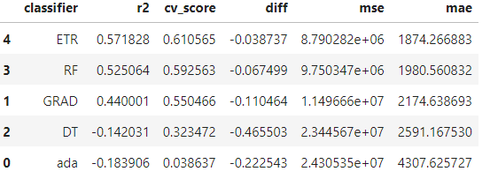
Model Selection
The target variable is price which is numerical continuous data datatype hence it is regression problem
Different models used were:
DecisionTreeRegressor
RandomForestRegressor
ExtraTreesRegressor
GradientBoostingRegressor
AdaBoostRegressor
Inference:
etr is the best model
highest r2_score and cv_Score
least difference between cv_sccore and r2_score
least error value for mse and mae

Slide 17
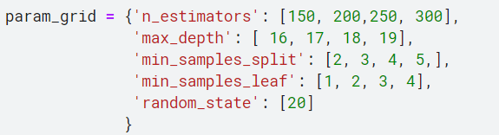
Hyper Parameter tuning
The different parameters used for tuning :
n_estimators
max_depth
min_samples_split
min_samples_leaf
The parameter value obtained after running grid search

Slide 18
Conclusion
There is a lot of variation in flight prices depending on the day of the week, departure city, destination city, and airline.
Prices tend to vary depending on the destination and day of travel.
Some destinations have prices that are consistent across multiple days, indicating that prices do not vary much.
Prices tend to be cheaper on certain days and more expensive on others.
Limited data is available for certain days, which could be due to flight not being operational on certain days, low demand on certain days, or data not being present in the dataset provided.
Prices are homogenous across days in certain cases, which could indicate that there is no significant change in prices across days.
The difference between Q1 and Q3 values is very low in many cases, which means the prices are homogenous across days in certain cases.
Factors such as seasonality, holidays and special events can also affect flight prices

Slide 19
Further Studies
Study the impact of external factors such as holidays, festivals, and special events on flight prices.
The data used has data from 8 to 11 and for few destination.
Analyze the data by different segments such as travel class etc
Study the impact of airport taxes and fuel prices on flight prices.
Conduct a survey of consumers to understand their behavior and preferences while booking flights.

Slide 20


